Slide 1
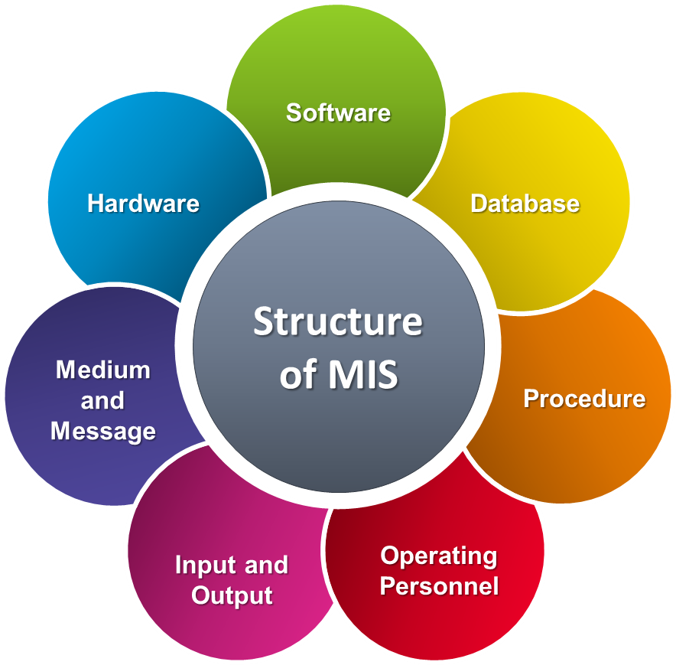
Mis
Mwayi mchuchu
Adjunct staff associate

Slide 2
scope
Understanding a system and defining MIS
Main Concepts of MIS
The role of MIS and its application in business
MIS Designs and functions

Slide 3
What is a system
A system is an ordinary grouping of interdependent components linked together according to a plan to achieve an object or objectives.
A system comprise of
A design to achieve intended objective
Components must be interrelated and interdependent
Concentrate on the objectives of the organization than that of sub system
System structure
Behavior (input, processing then output)
Interconnectivity of the elements
Functions or group of functions

Slide 4
Elements of a computer system
Elements or components of a system
Input - Capturing and assembling (Logical presentation)
Processor - transformation
Outputs - value to user
Controls - guides the system (eg max min value in a number field)
Feedback - actual against standard
Environment (eg if it’s a cloud based system it will work on the internet network environment)
Boundaries (system limitations in relation to the organization and environment)

Slide 5
MIS DEFINED
MIS is a computer based system that helps the organization, especially the managers, to organize and evaluate information and data, and provide information in a timely and efficient manner.
Management Information Systems (MIS) is the study of people, technology, organizations, and the relationships among them.
help firms realize maximum benefit from investment in personnel, equipment, and business processes.
a people-oriented field with an emphasis on service through technology.
If you have an interest in technology and have the desire to use technology to improve people’s lives, a degree in MIS may be for you. (but here in our ICT for tourism we only apply)
Basically a collective name referring to systems that harness the value of information

Slide 6
MIS THE KEY WORDS
Management focusing on the ultimate use of such information systems for managerial decision making
Information stressing on processed data in the context in which it is used by end users;
System emphasizing a fair degree of integration and a holistic view;
IN SIMPLE WORDS MIS CAN BE DEFINED AS
A system or process that provides information necessary to manage organizations effectively.

Slide 7
Mis concepts
MIS is not new, only the computerization part is new , before computers MIS techniques existed to supply managers with the information that would permit them to plan and control business operations. The computer has added on more dimensions such as speed, accuracy and increased volume of data that permit the consideration of more alternatives in decision-making process.
MIS as a computer system it includes;
Data banks (databases),
users (managers, Operators),
software (that processes data and produce reports to help make the decisions),
All hardware necessary (computer and network plus machinery hardware)
Combination of the above will enable MIS to scientifically collect, store, process and communicate information relating to various activities across the organization.

Slide 8
MIS and the business industry
As a business grows in size, the management of information and the decisions based on such data get more complicated.
Businesses use information systems at all levels of operation to collect, process, and store data. Management aggregates and disseminates this data in the form of information needed to carry out the daily operations of business.
A travel agent may use a web based MIS for customer booking, and use the same MIS to plan for specialized services based on the data on the most frequent booked trips and customer type.
Businesses concentrate on the alignment of MIS with business goals to achieve competitive advantage over other businesses. What is a competitive advantage?
MIS professionals create information systems for data management (i.e., storing, searching, and analyzing data). In other words these are key basic processes of each MIS to ensure business synergy
MIS Consolidates desperate data into meaningful information that aides decision making bottom up or reverse. (collective summarized reports)
helps managers evaluate progress and delegate work more efficiently, raising the overall efficiency of the organization.

Slide 9
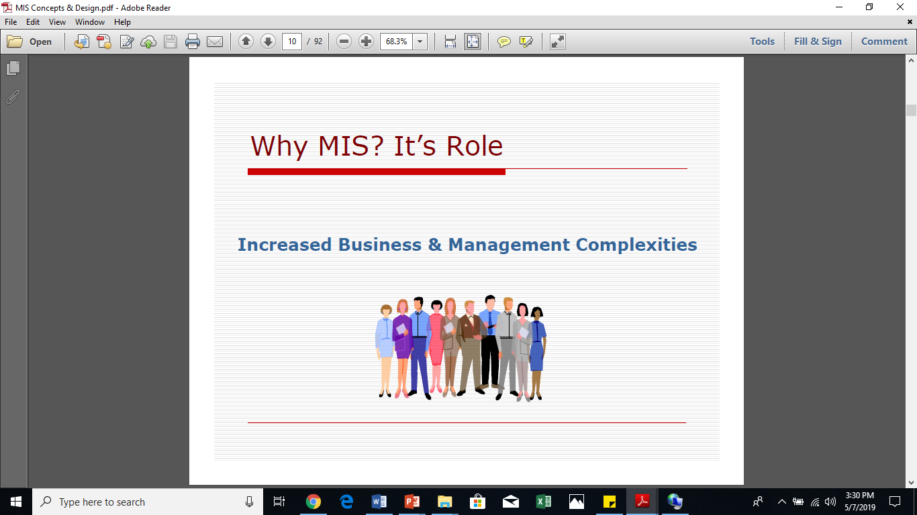
Mis and the business industry continued
Technological Revolution (catch up with technology) everyone is going digital MIS is the current and future of business management. Future businesses won’t be able to run without MIS. In Malawi how can u run a big company without MIS (think of paying employs, keeping financial records, tax and other regulations) If its hard in Malawi think of a cashless country.
Explosion of Information (Too much information hard to make a decision)

Slide 10
Functions of mis
Data Capturing:
MIS captures data from various internal and external sources of an organization. Data capturing may be manual or through computer terminals. End users, typically record data about transactions on some physical medium such as paper form or enter it directly into a computer system.
Processing of data:
The captured data is processed to convert it into the required management information. Processing of data is done by such activities as calculating, comparing, sorting, classifying and summarizing.
Storage of information:
MIS stores processed or unprocessed data for future use. If any information is not immediately required, it is saved as an organizational record.
Retrieval of information:
MIS retrieves information from its stores as and when required by various users. (usually on demand or as set)
Dissemination of Analyzed Management Information
Management information, which is a finished product of MIS, is disseminated to the users in the organization. It could be periodic, usually through reports.

Slide 11
Mis information processing functions
Information System Processing functions is part of the MIS design structure, responsible for
processing of transactions (payments, billing and invoices)
maintain master files (ensure all data is secured, and correlated in the master file)
produce reports (on demand and structured reports)
process enquiries (prospectus profiling eg by region, age group, product or service line which products are within the most enquired)
process interactive support applications (such as feedback forms )

Slide 12
Functional uses of mis
Enhance :
Quality of our operations
Quality of our services
We achieve :
Efficiency
Transparency
Speedy Decision making

Slide 13
Strategic Uses of MIS
Precise development of strategies, ( Can help organization set business growth strategies ) eg targets in terms of sales and or market share. Based on financial performance reports trends for a number of previous years.
right information in right time to right people
planning, forecasting and monitoring (eg if sunbird have advanced 3months booking for 50% of all its services, it would easily forecast quarterly profit margin)
Problem solving (it is easy to solve a problem if you know the source) MIS will provide you with information on various business aspects. Eg Suppose MIS annual reports shows that the sales department fell short with 20% of the financial year target and that you had staff turnover of 30% within the marketing and sales department what would be your impression?
Decision-making (based on the above example report what possible strategic decisions would be put in place to ensure sales staff reach their target goals)

Slide 14
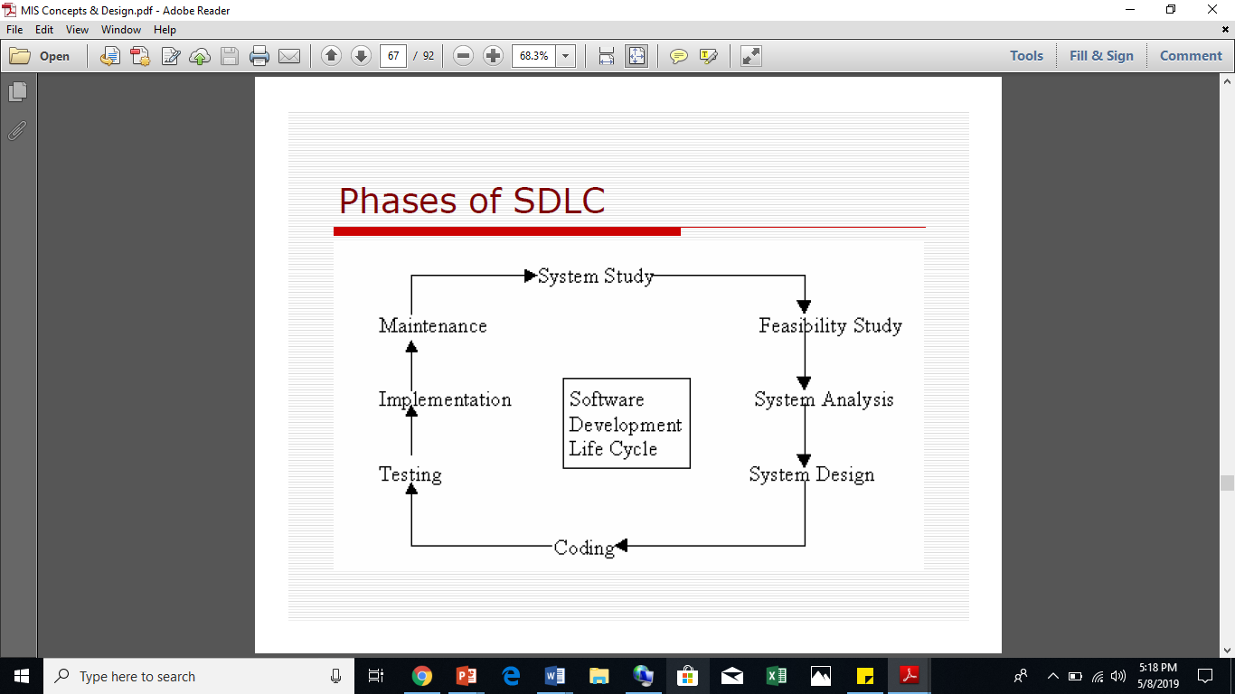
Designs OF MIS
Before going into the design lets have a look at the system development cycle
MIS are designed to provide past, present, and future routine information appropriate for planning, organizing, and controlling the operations of a functional area in an organization
MIS is made up of 5 main components
Hardware,
Software
Data
Procedures
People

Slide 15
The MIS DESIGN THEORY
✓ Right Information
✓ To the right person
✓ At the right place
✓ At the right time
✓ In the right form
✓ At the right cost
A management information system (MIS) is designed to provide information for use by different types of managers.
This type of system can create reports that meet the needs of managers at different levels.
Senior-level managers need different types of information than mid- or low-level managers. These people may need entirely different types of information, or to view the same type of information in unique ways.
Senior managers might be interested at business overall performance, (profit / loss)
Line manager (quality) assurance will be interested in number of complaints and product returns against number of complements or positive product / service rating.

Slide 16
Mis design theory continued
The MIS Design should be;
Management oriented
Management directed (control)
Integrated system
customizable, scalable
Design should Involve large planning (a greater perspective of what if scenario to involve multiple operating environments) Think of cloud based systems and our internet plus power interuptions.
Sub systems (individual working components which are part of the system but can function and be evaluated separately)
User-machine system that is flexible to use

Slide 17
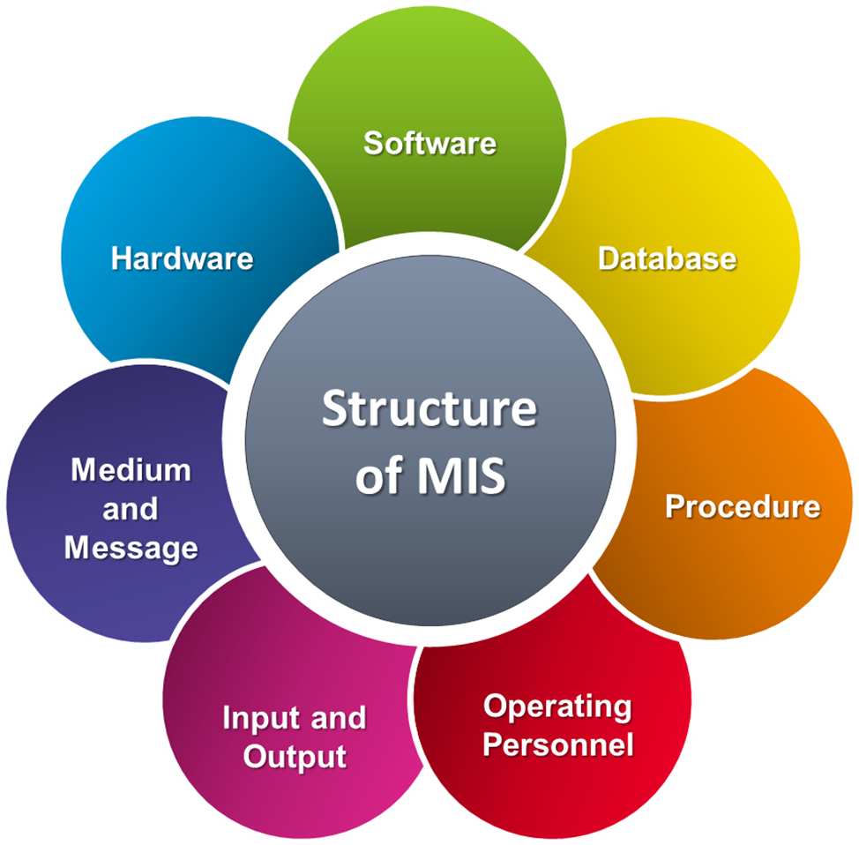
Mis general physical structure
Hardware (CPU, and all of its support equipment's)
Software (computer programs and the manuals )
Database (facts used by programs to produce useful information.)
Procedures (policies that govern the operation of a computer system)
Operating personnel (end user of the Systems.)
Input and output ( data output information)

Slide 18
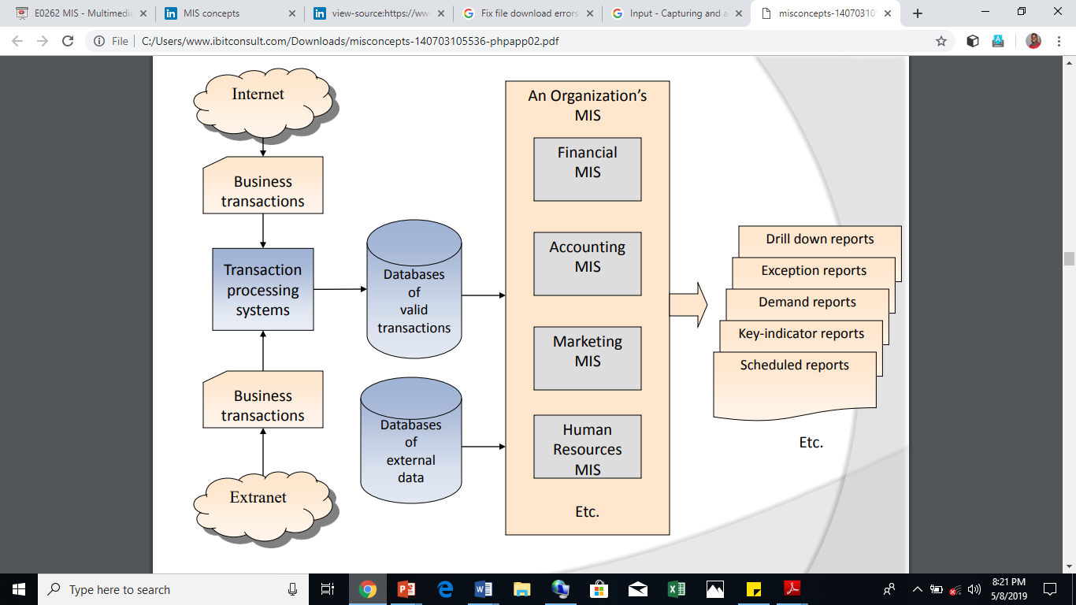
Mis functional based structure
External data
(research & dev)
Competitors
System Setup is usually based
On high level Functional requirements
Internet Transaction(Clients booking and paying services online, providing feedback online etc)
Extranet (Stores manager working from home eg authorizing internal stock order, to ensure operations continuity )

Slide 19
Mis modules
MIS Has a set of Core Functional Sub systems discrete to specific organization’s department operations, All the modules can work as separate unit while being integrated within the main system’s architecture. These are most common MIS modules.
Management Reporting System. A management reporting system is a database designed to report on the finances and operations of all levels of management in an organization.
Accounting and Finance.
Sales and Marketing. (promotions evaluation, suggesting best sales or marketing channels based on environment or external research data)
Inventory Control.
Human Resources.
Office Automation/Enterprise Collaboration.(preset customizable templates for other frequent communications such as memos letters etc easy letter merge for clients communications etc)
Process Control (maintain a process at the desired operating conditions, think of this like how baking and temperature control goes in hand) That process can be automated

Slide 20
Mis financial module
Provides financial information to all financial managers within an organization.
MIS has many responsibilities to the accounting function. Payroll processing and reporting, as well as tax accountability are major functions for the MIS department.
In addition, all reporting and documentation for payroll and tax matters fall to MIS.
Weekly, monthly, quarterly and year-end reporting to management are also important duties for MIS. Compliance with all federal, state and local agencies eg tax, city rates, as well as reports to both governmental agencies and management are also vital for your MIS department.

Slide 21
Inputs and outputs of the mis financial module
Inputs may include → Strategic plan or corporate policies Contains major financial objectives and often projects financial needs. (profit projections, sales targets etc)
Transaction processing system (TPS) (data for each transaction, eg bill payments)
Important financial information collected from almost every TPS - payroll, inventory control, order processing, accounts payable, accounts receivable, general ledger.
External sources, Annual reports and financial statements of competitors.
Financial MIS Subsystems and Outputs → Financial subsystems
Profit/loss and cost systems , Auditing
Internal auditing
External auditing
Uses and management of funds

Slide 22
Service provision /manufacturing mis module
Perhaps no other department depends on your MIS department more than operations. Sales and profits information must be received at least daily in order for your company to operate properly. Staffing decisions, including scheduling assignments, are based on reports generated through your MIS department. Monthly, quarterly and yearly financial statements, as well as expense reporting information must be received by operations from your MIS associates.
Without MIS input, operations is literally flying blind and cannot function properly in this highly competitive environment.
MRP (Manufacturing Resource Planning reports) The bill of materials is a listing of all the raw materials, component parts, subassemblies, and assemblies required to produce one unit of a specific finished product
JIT (Just In Time inventory reports, to ensure continuity in production) System can send restaurants inputs summary reports when inventory is equal or less than set capacity eg 5% minimum quantity.
CAD (Computer Aided Design) Ensuring output product be as designed (eg cars)

Slide 23
Inputs/ outputs for the mis service/ manufacturing module
Inputs to the Manufacturing MIS → Strategic plan or corporate policies., The TPS: Order, processing, Inventory data, Receiving and inspecting data, Personnel data(clients personal data), Production process and External sources.
Outputs
Design and engineering, Master production scheduling, Inventory control, Manufacturing resource planning, Just-in-time inventory and manufacturing, Process control, Computer-integrated manufacturing (CIM), Quality control and testing.

Slide 24
mis Marketing module
marketing function depends on MIS for many of its most important activities.
Sales and product analysis information is required and generated daily by your MIS.
Ordering information, from which product and services details are generated, must be quickly and accurately received through the function of MIS associates.
Decisions on product placement, as well as marketing strategies are created through the efforts of MIS reports.
Marketing management makes all major decisions after analysis of data generated by your MIS team.
It is important to ensure that the MIS Marketing module is designed inline with the core marketing functions and trending marketing concepts. Eg if a company decides to run a marketing campaign online the MIS should also be able to separately aggregate all new services enquiries and sales leads to assess the marketing campaign effectiveness.

Slide 25
Inputs and outputs in a Marketing MIS
Inputs
Strategic plan and corporate policies
The TPS
External sources:
The competition ( Competitor analysis)
The market (marketing research findings) Online system can populate such data
Marketing MIS Subsystems and Outputs
Marketing research (analyzed report, )
Product development (for example need for health eating = more organic meals local chicken)
Promotion and advertising (right service promotion, channel to the right customer )
Product pricing (how are our competitors pricing similar services)

Slide 26
Human Resource MIS module
Human Resources relies heavily on your MIS department.
All benefits information, from program administration fall to the MIS department to implement and track.
In addition, the training and development department relies on MIS to enroll and monitor participants in their training program through their learning management systems. (who went for training, who is next, costs and performance implications)
Performance reviews and salary administration also must be managed through your MIS department. All reports for all employees also are a major accountability for the MIS team.

Slide 27
Inputs and outputs in the Human Resource MIS module
Inputs
Strategic plan or corporate policies, employee handbooks
Discrete TPS (eg employee based TPS data)
Payroll data
Employee's professional conduct
Personnel data
External sources (labor laws on minimum wage, )
Human Resource MIS Subsystems and Outputs
Human resource planning (based on strategic plans will we need more staff or downsize)
Personnel selection and recruiting (are we understaffed? )
Training and skills inventory (which staff needs training, what skills do we have in house)
Scheduling and job placement (shifts, short long term placements)
Wage and salary administration reports
System recommended automated decision (warning,suspend, fire / short list, hire, promote)

Slide 28
Decision support systems (DSS)
A decision support system is a computer application that helps users analyze problems and make business decisions more confidently.
This can be an independent system or essential part of the MIS
It uses data routinely collected in organizations and special analysis tools to provide information support to complex decisions.
DSS is more suited to handling unique and non-routine decision problems.
Each problem might require a different approach to problem definition, analysis and resolution.
Decision support systems (DSS) are computer-based information systems that are designed with the express purpose of improving the process and outcome of decision making.

Slide 29
Decision making with DSS
DSS is designed to support managerial decision-making, usually, at middle and top levels of management.
There two main types of decision making approaches Futuristic and Programmable
Decisions made at the top level are mostly futuristic and nonrepetitive in nature.
Such decision situations are highly uncertain and even specification of information requirements for decisions are difficult.
They are classified as non-programmable or unstructured decision situations. The cost of a wrong decision is usually very high, for example a decision to sell off a line of business.
This is in sharp contrast to programmable or structured decisions where the decision procedure can be well defined and every information requirement can be pre-specified. Most of the decisions taken at lower levels of management fall into this category.

Slide 30
Dss Design approach
The physical design of a successful DSS must follow a logical design, which in turn must be guided by the decision-making process. In particular, designers should ask the same fundamental questions as those on which reporters rely:
Who needs the DSS?
What advantages does the user expect by using the DSS?
When will the DSS be used?
Where does this system fit into the general business process?
Why is a DSS needed?
How will the DSS be used?

Slide 31
Characteristics of dss
It is designed and run by managers. (obviously most crucial decisions are made by managers)
It contains a database drawn from internal files and external environment.
It focuses on decision processes rather than on transaction processing.
It is concerned with a small area of managerial activity or a small part of a large problem.
It permits managers to test the probable results of alternative decisions.
It supports decision-making, usually in solving semi-structured complex problems.
It helps in refining managerial judgment applied to problem solving.
It improves managerial decisions and thereby managerial effectiveness.
The decision maker retains control over decisions throughout the decision process.

Slide 32
End of presentation
any questions?

